Slide 1
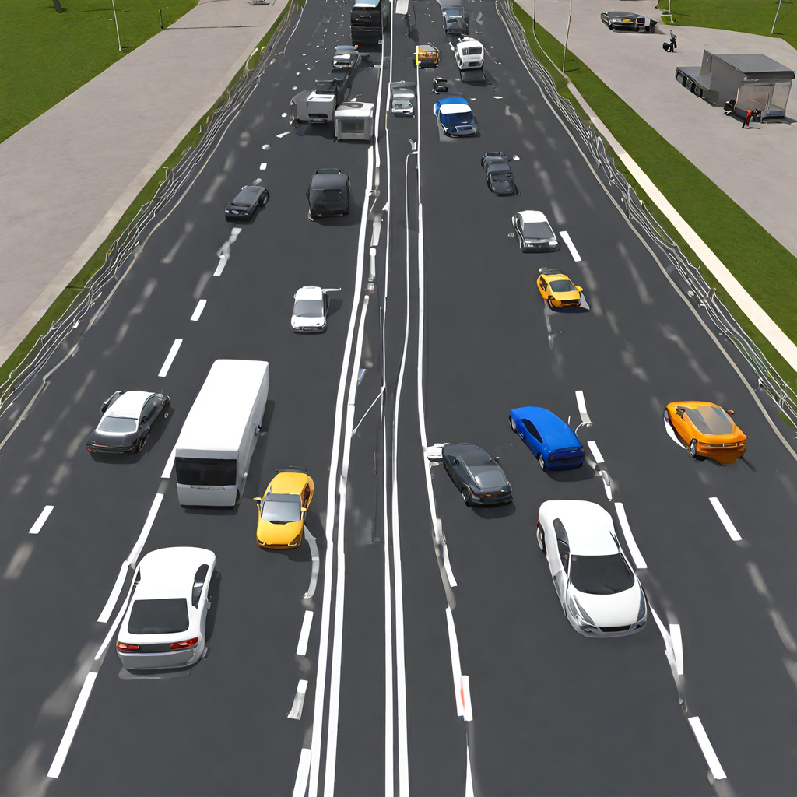
ENHANCING ROAD SAFETY WITH V2V SIMULATIONS
Team 22

Slide 2
Motivation
https://github.com/Ujwal2910/Smart-Traffic-Signals-in-India-using-Deep-Reinforcement-Learning-and-Advanced-Computer-Vision/blob/master/README.md

Slide 3
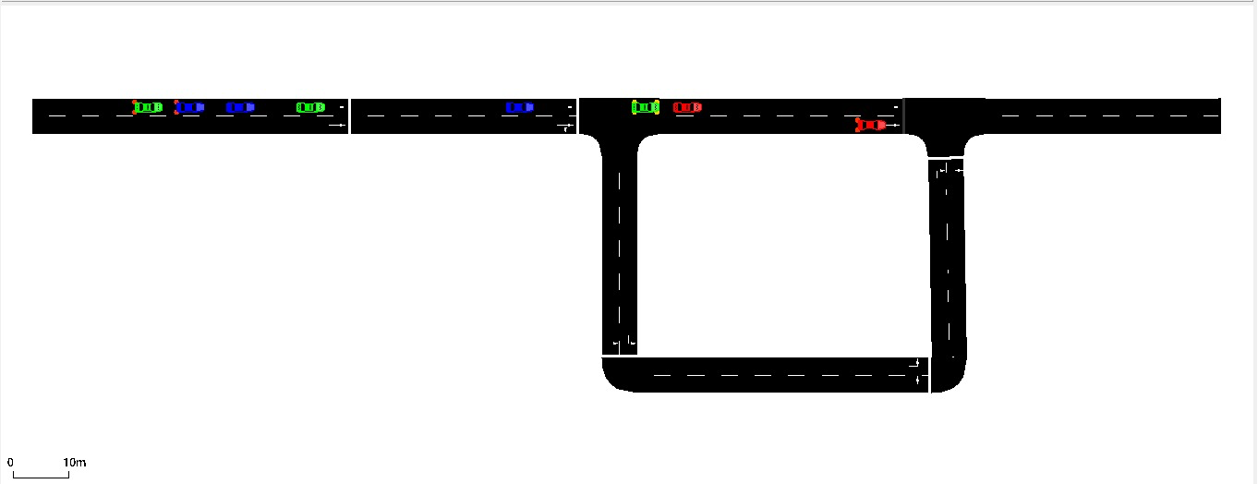
The Environment (SUMO)

Slide 4
STATES
ACTIONS
REWARDS
Position
Speed
Acceleration
Direction
Lane
States of Nearby Vehicles.
Accelerate
Decelerate
MaintainSpeed
ChangeLane
Turn
Collision penalty
Reaching end goal reward
Stopping penalty
Contradicting Penalty

Slide 5
we are using
Deep Q Network

Slide 6
Model architecture
Input Linear Layer
RELU
Activation
Hidden Linear Layer
RELU Activation
Output Linear Layer
Sigmoid Activation
STATES
ACTIONS

Slide 7
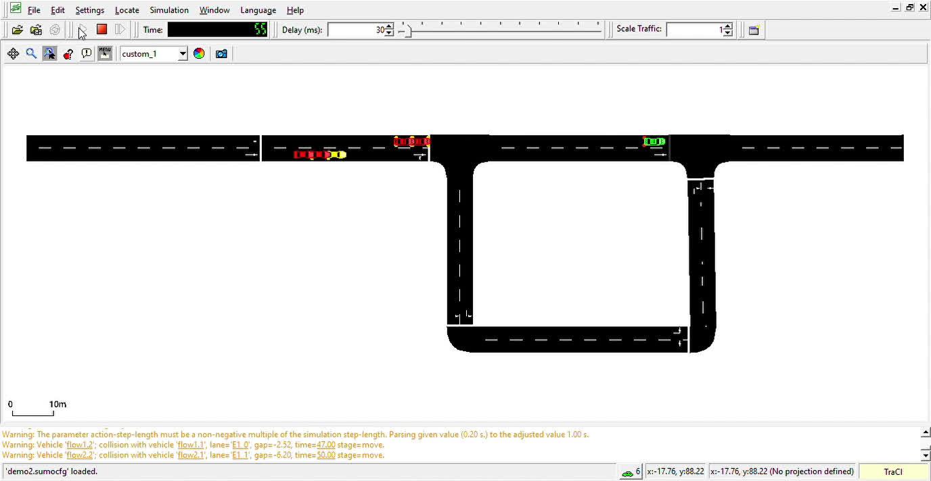
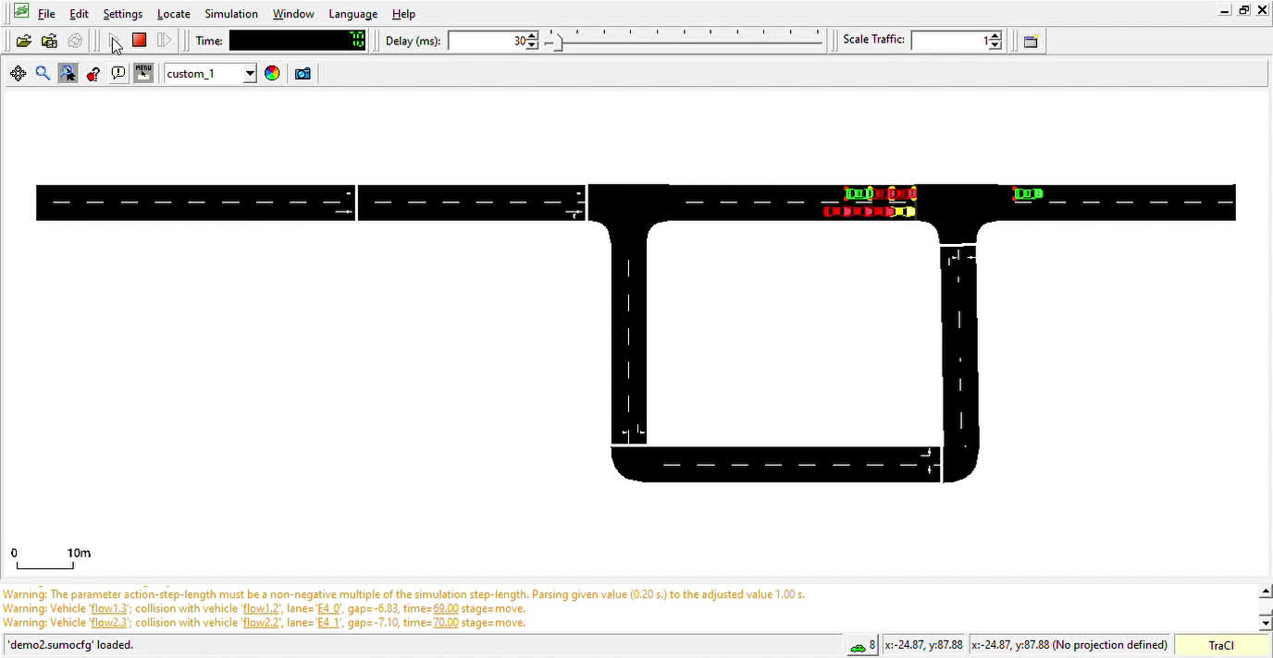
Ready, Set, Go!
Model learning in action!

Slide 8
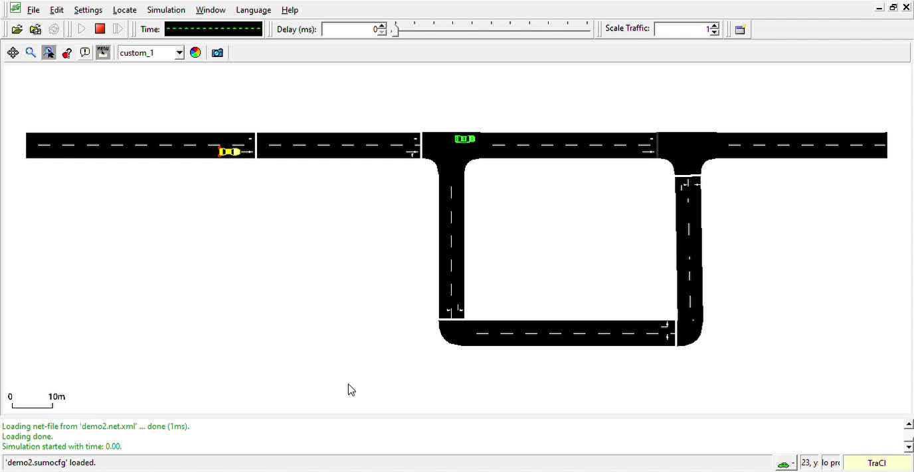
And Finally!
At much later episodes...

Slide 9
Conclusion and
Future Work
1
This works! But not that great. Still, it is a step taken towards utilizing V2V communication to avoid accidents.
2
Future works:
Pedestrians
Giving way to priority vehicles
Complex Road Networks
3
Limitations:
Non-autonomous vehicles
Data Privacy
Human Behavior

Slide 10
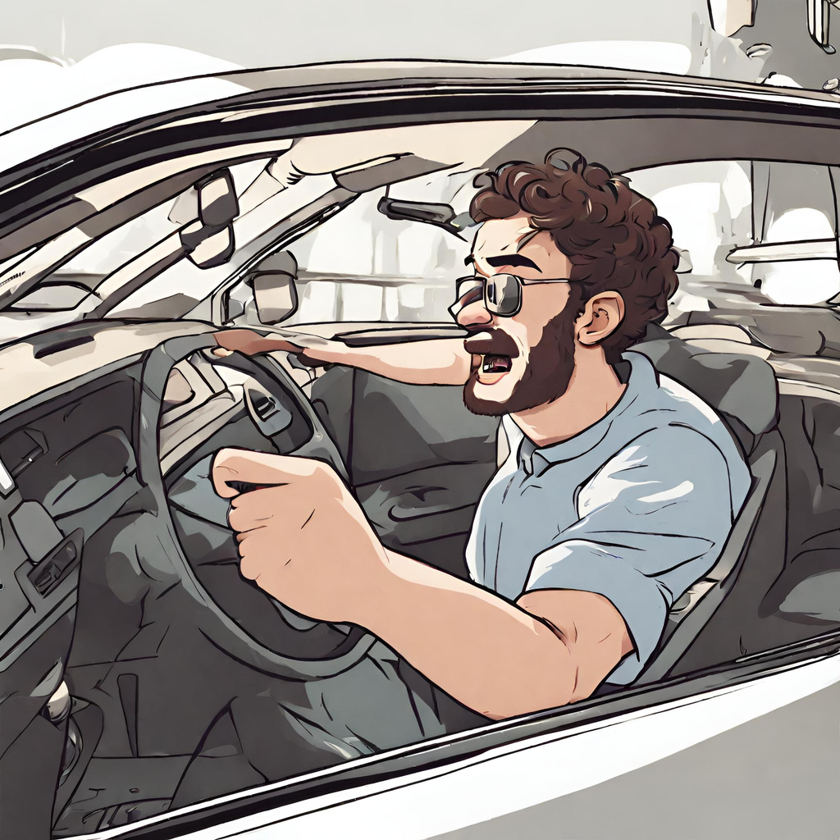
Do you have
any questions?
We hope you’ve learnt something new.

Slide 11
Thank You

